Slide 1
App Recommendation: A Contest between Satisfaction and Temptation
Peifeng Yin et al., Pennsylvania State Univ.
ACM International Conference on Web Search and Data Mining (WSDM) 2013
26 July 2013
Hyunwoo Kim

Slide 2
Outline
Introduction
Actual-Tempting Model
Evaluation
Conclusion

Slide 3


Status
5 years old
900,000 apps hosted on the store
50,000,000,000 app download
$10,000,000,000 to developers
Good Recommendation

Slide 4
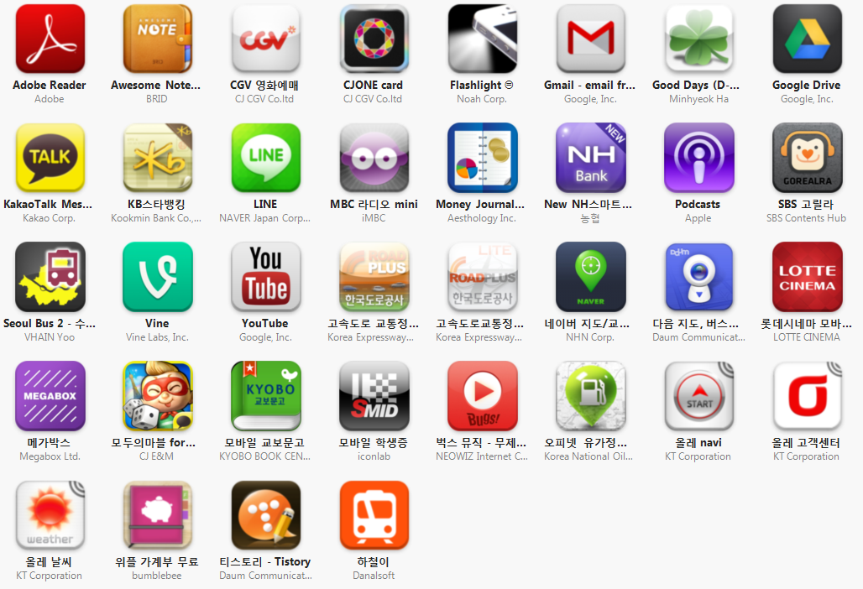
Apps

Slide 5
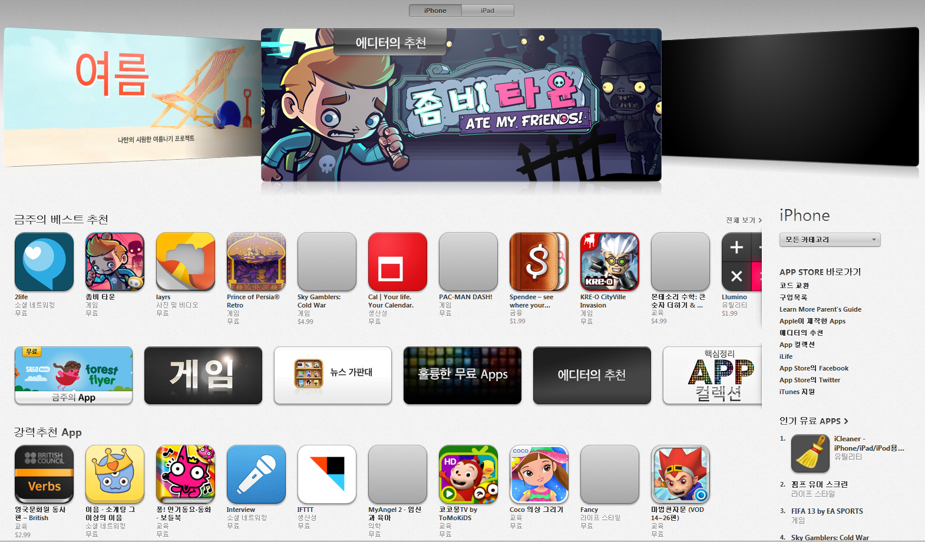
App Store

Slide 6
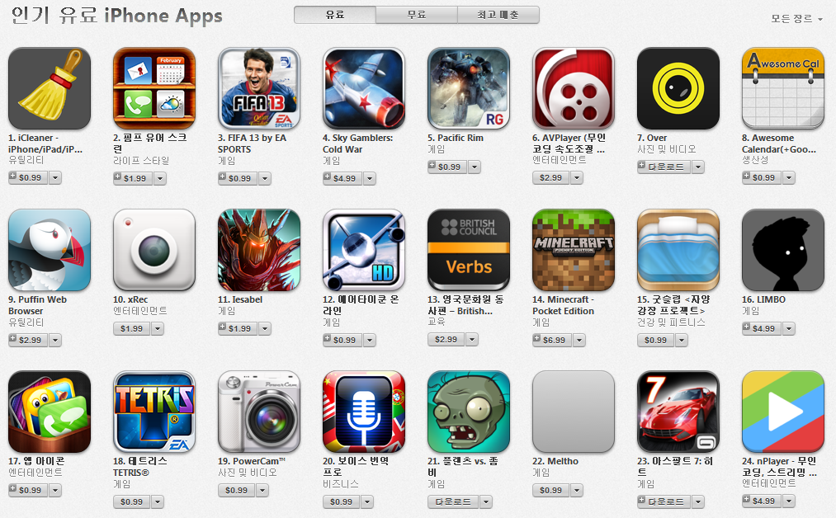
Popular Apps
No Personalization

Slide 7
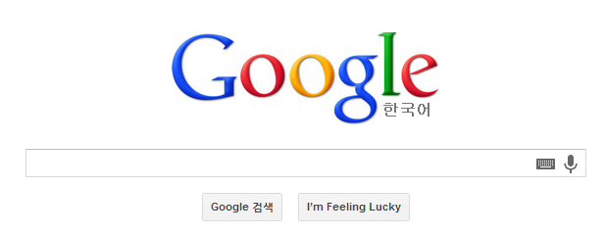

App Recommendation Service
Keyword search
Good Recommendation

Slide 8
Outline
Introduction
Actual-Tempting Model
Evaluation
Conclusion

Slide 9





Recommendation Services
Conventional items
Mobile apps
One-shot consumption
Continuous consumption

Slide 10
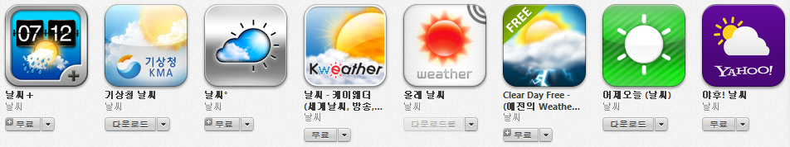
Recommendation Services
Avoiding similar items
Analysis of user downloading log
Some users did download multiple similar apps

Slide 11
Pick-and-Take
Pick
Take
Decision to download the app
Influenced by contest between already-owned apps and the candidate app

Slide 12





Actual vs. Tempting
Actual value
Assessment of satisfactory
Real value of the app after is it used
Tempting value
Assessment of attractiveness
Estimated value of the app seems to bring
Whether to download some apps or not
Result of contest between owned apps’ actual value and the candidate’s tempting value
???
>
<
actual
tempting
actual
tempting

Slide 13
Scenarios of Failed Recommendation
Phenomenon of app contest
Important factor in app adoption
Incorporated in app recommendation
user downloads the app
app is recommended to the user

Slide 14

Learning Process
Learning from users’ view/download sequence
Large number of downloads
Actual value of the owned app < tempting value of the candidate app
Small number of downloads
Actual value of the owned app > tempting value of the candidate app
view/download
own

Slide 15
Influence
Not all of apps may affect user’s decision
New metric function overlap, ranging from 0 to 1
Similarity between two apps
view
own
( , ) = 1
( , ) = 0

Slide 16
Contributions
Reveal two item access patterns
One-shot and continuous consumption
Analyze why the state-of-the-art recommendation techniques fails
UCF, ICF, CBR
Propose an Actual-Tempting model
To capture the contest between apps
Conduct extensive experiments to evaluate Actual-Tempting model

Slide 17
Outline
Introduction
Actual-Tempting Model
Evaluation
Conclusion

Slide 18
Indication of Actual and Tempting Values
Positive correlation where larger actual value suggests a higher rating
With the growth of tempting value, download probability is also increasing

Slide 19
General Performance
Actual-Tempting model outperforms baseline models

Slide 20
Outline
Introduction
Actual-Tempting Model
Evaluation
Conclusion

Slide 21
Conclusion
We propose Actual-Tempting model to exploit the app contest phenomenon for app recommendation
Good Recommendation

Slide 22
Thank You

